Slide 1
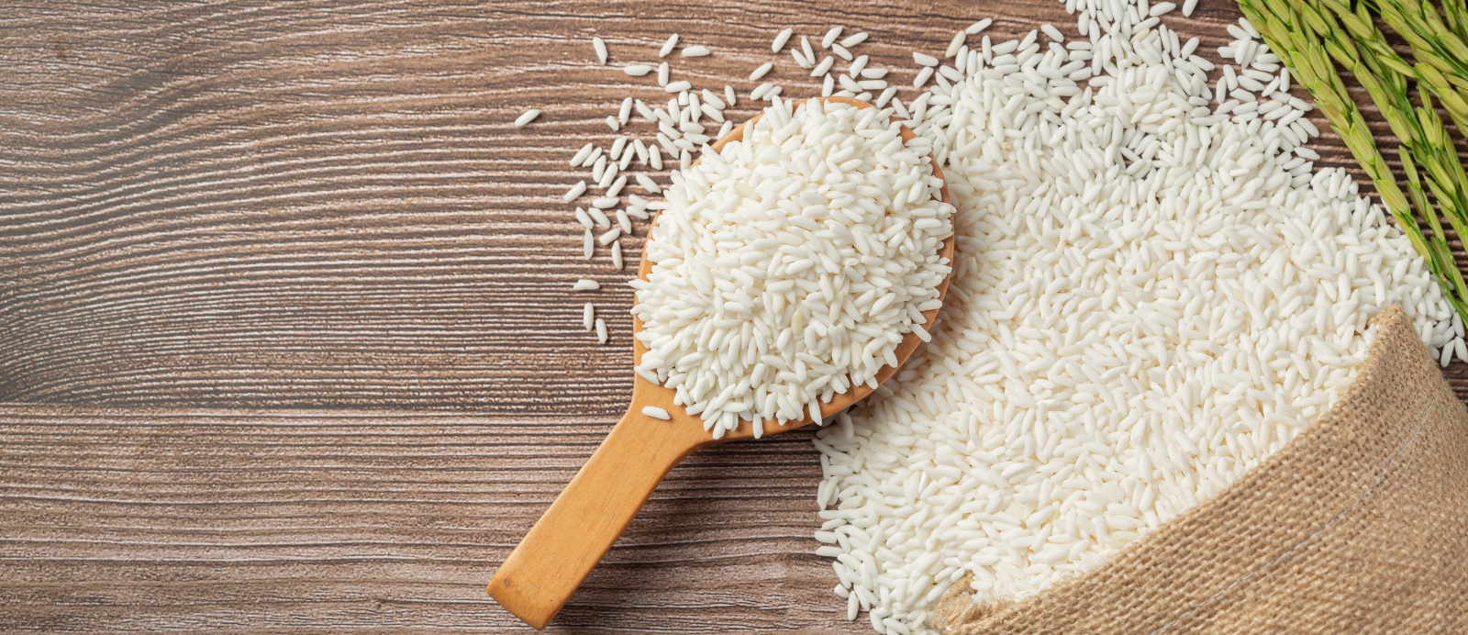
CAPSTONE PROJECT- GROUP 5
RICE GRAIN IMAGE CLASSIFICATION

Slide 2
Group Members
1.Bethuel Maruru
2.Yvonne Kirigo
3.Sonia Ojay
4.Faith Mwenda
5.Jane Martha
6.Loise Mburuga

Slide 3

Business understanding
The agricultural sector is advancing rapidly, requiring efficient and precise classification methods.
Traditional methods are labor-intensive and error-prone, necessitating automation.
In rice farming, accurate classification is crucial for quality control and market pricing.
This study aims to classify rice grains based on features such as shape and color.

Slide 4

Objective
The primary objective of this project was to develop a machine learning model capable of accurately classifying different types of rice grains based on their images.
The classification was performed using a dataset comprising various rice types, each with distinct visual characteristics.

Slide 5
Data Collection and Preparation
The dataset in study is obtained from https://www.muratkoklu.com/datasets/
This study comprises of 75,000 images of five varieties of grains, Arborio, Ipsala, Jasmine, Karcadag and Basmati from Turkey.
The data was preprocessed by resizing images, augmenting and normalizing before modelling.

Slide 6
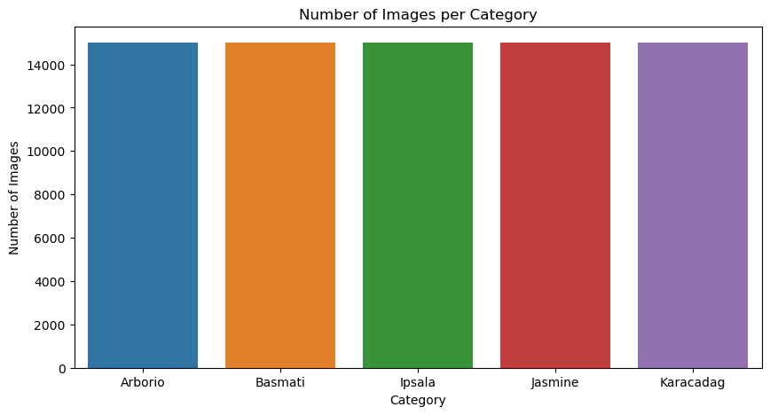

Visualizing data distribution
This shows a graphical distribution of the categories of rice with 15,000 images each.

Slide 7
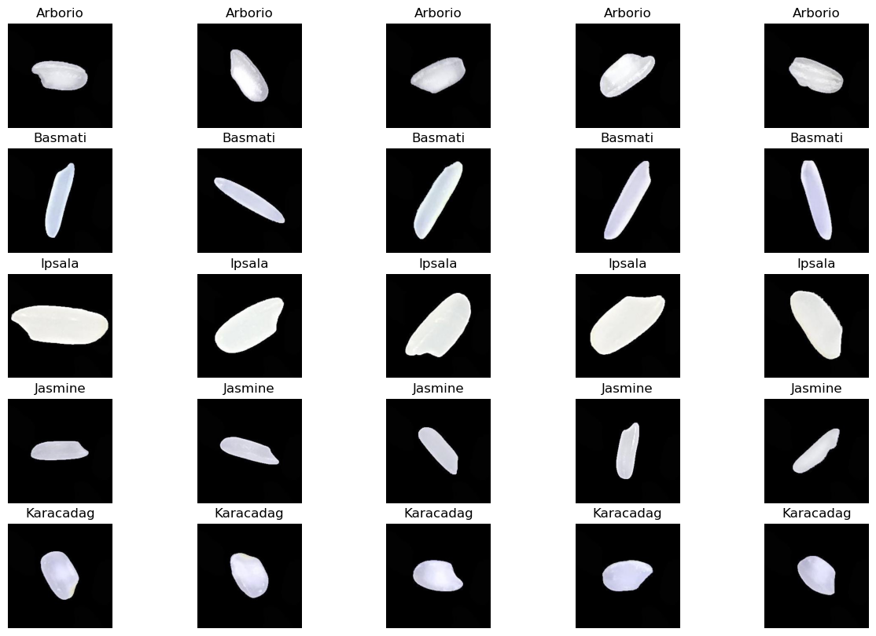
Visualizing rice category images
Notes:
Shape: All rice classes are elongated and not circular. The eccentricity of each was close to 1 and not 0 which signifies elongated in shape

Slide 8
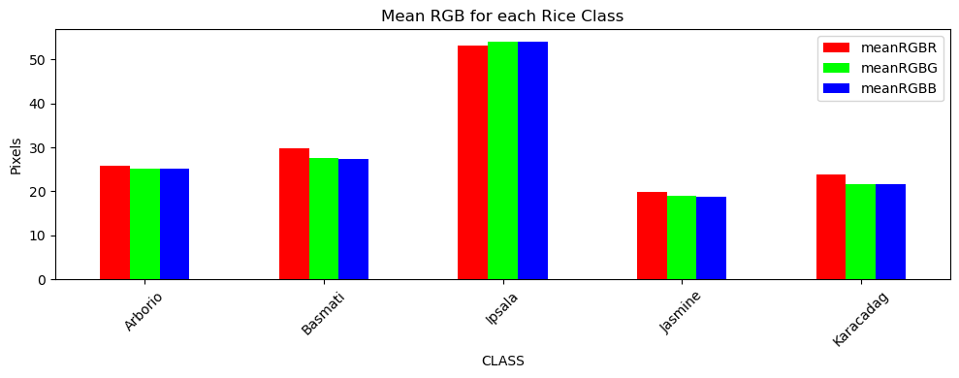
Colour Visualization
Ispala has a higher colour intensity as compared to the other rice classes.
The average intensity of the three colour is almost the same in the different rice classes.
Notes:
Higher color intensity makes it easier to identify

Slide 9
Model Architecture
The three model types used are sequential models with convolutional layers:
1. General purpose CNN model
2. Pretrained ResNet50V2 model
3. The VGG-16 model
The models contain different layers of evaluation with variation in each stage depending on each model performances.
Notes:
Layers: Conv2D with 32 filters, Conv2D with 64 filters, Conv2D with 128 filters (optional), Dense layers with dropout for regularization. Conv2D with 32,64 and 128 filters refers to the 2-dimensional nature of the input data and each layers will learn 32, 64 and 128 different features or patterns from the data respectively.
The dense layers combines the features learned by the model convolution layers and makes final classification and prediction.

Slide 10
Model Compilation and Training
The model was adjusted and improved which helped it learn more effectively. When the model tried to sort rice grains into different categories, it used a method that helped it understand how close it was to the correct answer and guided it to improve.
It evaluated performances using accuracy, our target accuracy was 92%.
The training process ran 10 epochs using validation data to monitor performance with the total duration representing the complete time taken to train the model.
Notes:
Epoch: This is a complete pass through the entire training dataset by the learning algorithm. Each epoch took approximately 30 minutes and increased up to 60 minutes with the advanced models.

Slide 11
General Purpose CNN model

Slide 12
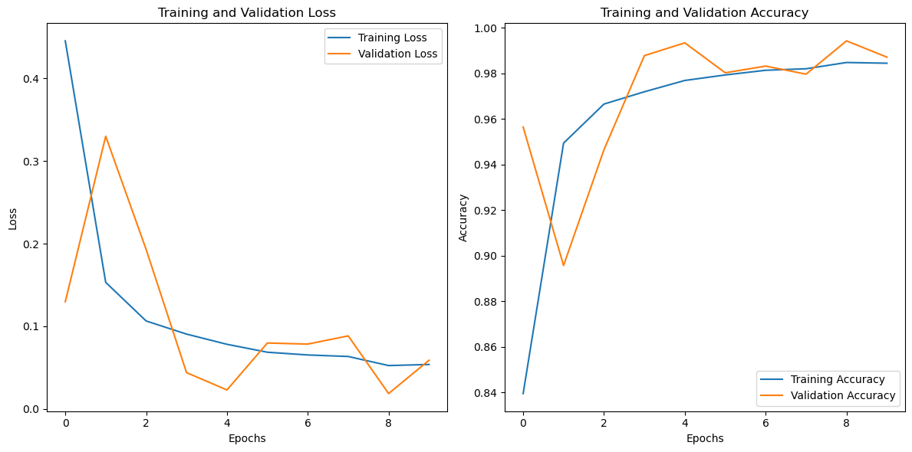
Evaluation and Results Visualization General purpose CNN Model
Validation and training loss continuously decreased over each cycle
Validation and train accuracy steadily increased over each cycle
Notes:
The provided plots illustrate the training and validation loss and accuracy over epochs for a machine learning model. The training loss decreases steadily, indicating that the model is effectively learning from the training data. While the validation loss also decreases initially, it begins to fluctuate after a few epochs, suggesting potential overfitting. The training accuracy shows consistent improvement, and the validation accuracy, despite some fluctuations, remains high and close to the training accuracy, indicating good generalization to unseen data. To further enhance model performance and mitigate overfitting, techniques such as early stopping, cross-validation, regularization, and data augmentation could be considered. Overall, the model demonstrates strong learning and generalization capabilities, albeit with minor signs of overfitting in the validation metrics.

Slide 13
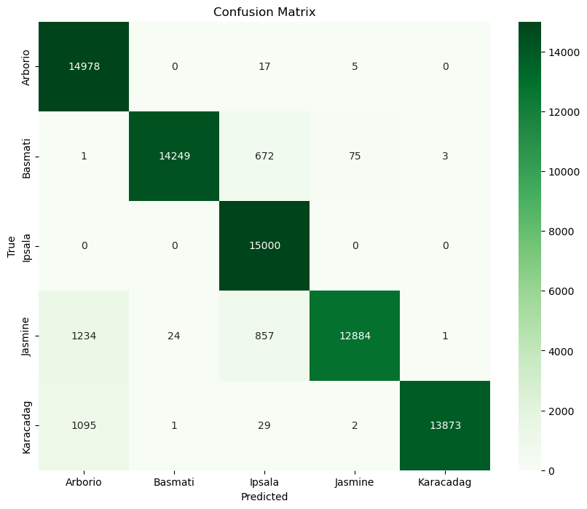
Evaluation and Results Visualization General purpose CNN Model
Ipsala had the highest rate of true positives at 15,000
Jasmine had the lowest rate of true positives at 12,884
Notes:
The confusion matrix shows that the model performs exceptionally well with high correct classification rates, particularly for Ipsala, which has a perfect classification. There are minor misclassifications, mainly for Jasmine and Basmati, which could indicate similarities between these classes that the model finds challenging to distinguish. The overall performance is strong, with most classes having a high number of correctly classified instances and relatively low misclassifications.

Slide 14
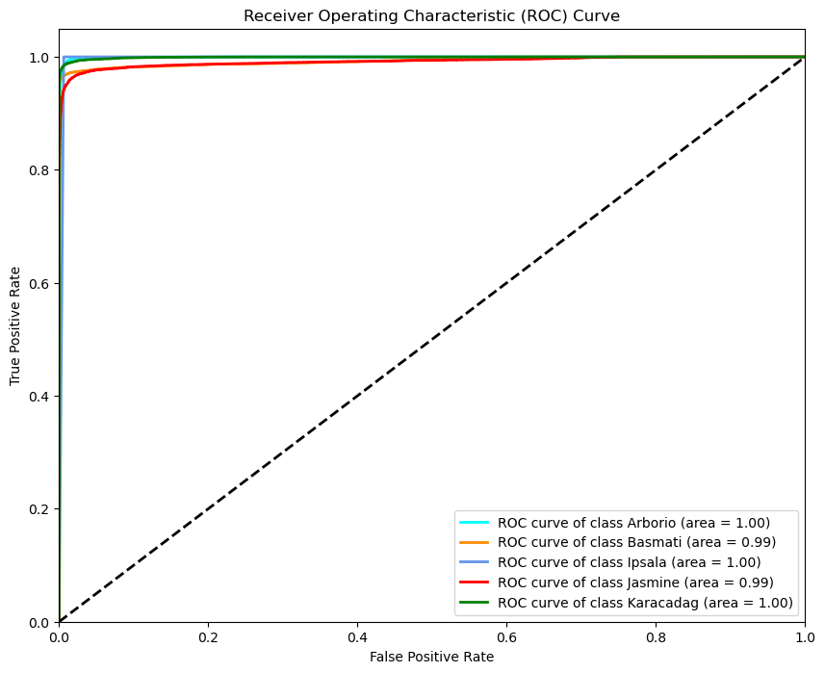
Evaluation and Results Visualization General purpose CNN Model
Notes:
The ROC curves and AUC values demonstrate that the model performs exceptionally well for all classes, with nearly perfect classification for Arborio, Ipsala, and Karacadag (AUC = 1.00) and excellent performance for Basmati and Jasmine (AUC = 0.99). This indicates that the model is highly accurate and effective in identifying the correct class for each instance.

Slide 15
ResNet50V2 Model

Slide 16
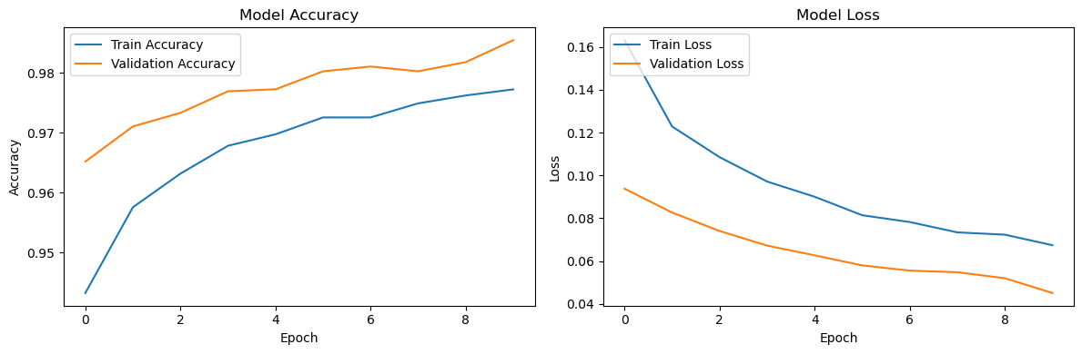
Evaluation and Results Visualization Pre-trained ResNet50V2
Validation and training loss continuously decreased over each cycle
Validation and train accuracy steadily increased over each cycle
Notes:
Model Accuracy: The training accuracy (blue line) steadily increases, reaching approximately 98.77% by the end of the training process. The validation accuracy (orange line) also rises, consistently outperforming the training accuracy and approaching 98.87%.
Model Loss: The training loss (blue line) continuously decreases, dropping to about 0.0364 by the end of the training. The validation loss (orange line) also shows a steady decline, reaching around 0.0348, indicating effective learning and generalization.

Slide 17
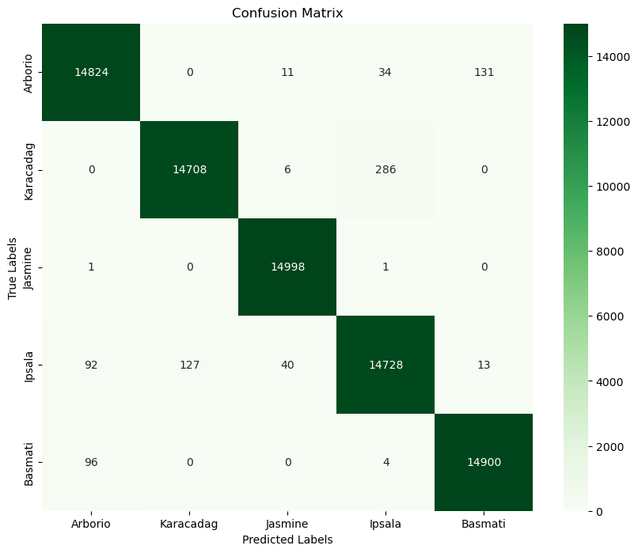
Evaluation and Results Visualization Pre-trained ResNet50V2
Jasmine had the highest rate of true positives at 14,998
Karacadag had the lowest rate of true positives at 14,708
Notes:
The confusion matrix for the rice grain classification model demonstrates strong performance across all five rice grain varieties: Arborio, Karacadag, Jasmine, Ipsala, and Basmati. The diagonal elements, representing the correctly classified instances for each variety, are notably high, indicating excellent precision and recall. Specifically, Arborio was correctly classified 14,824 times, with only minor misclassifications (11 as Jasmine, 34 as Ipsala, and 131 as Basmati). Karacadag was correctly classified 14,708 times, with 286 instances misclassified as Ipsala. Jasmine achieved almost perfect classification with 14,998 correct predictions and only two misclassifications. Ipsala had 14,728 correct predictions, with the majority of misclassifications occurring as Karacadag (127 instances). Basmati was correctly classified 14,900 times, with very few misclassifications (96 as Arborio and 4 as Ipsala).

Slide 18
VGG-16 model

Slide 19
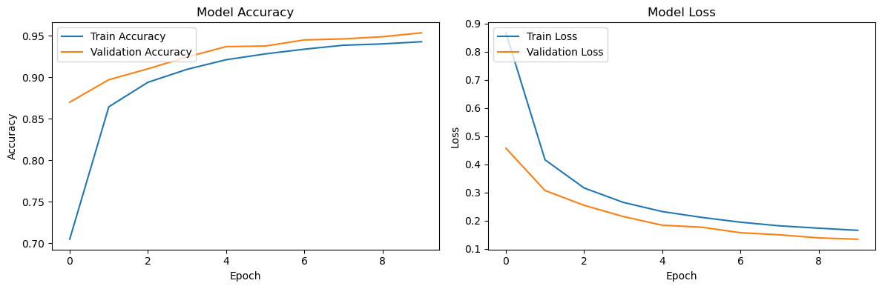
Evaluation and Results Visualization VGG-16
Validation and train accuracy steadily increased over each cycle
Validation and training loss continuously decreased over each cycle
Notes:
Model Accuracy (Left Graph):
The training accuracy (blue line) starts at around 70% and rapidly increases, reaching approximately 94% by the 10th epoch. The validation accuracy (orange line) begins slightly higher than the training accuracy and also increases steadily, leveling off around 95%. The close alignment and steady increase of both training and validation accuracy indicate that the model is learning effectively without significant overfitting. The validation accuracy consistently being higher or very close to the training accuracy is a positive sign of good generalization.
Model Loss (Right Graph):
The training loss (blue line) starts at around 0.9 and decreases significantly, reaching approximately 0.1 by the 10th epoch. The validation loss (orange line) also decreases from about 0.5 to just below 0.1. The continuous decrease in both training and validation loss demonstrates that the model is effectively minimizing errors during training and validation phases. The close tracking of validation loss with the training loss further confirms the model's strong generalization performance.

Slide 20
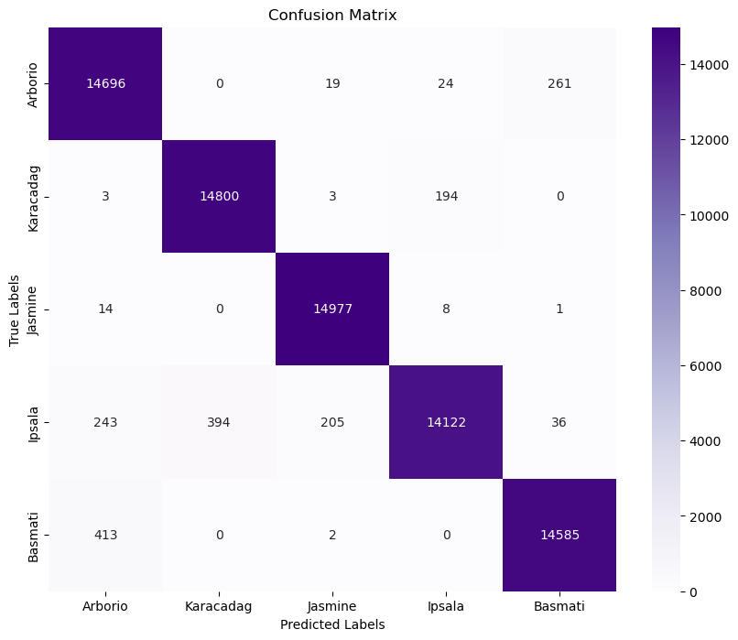
Evaluation and Results Visualization VGG-16
Jasmine had the highest rate of true positives at 14,977
Ipsala had the lowest rate of true positives at 14,122
Notes:
The confusion matrix demonstrates the high accuracy of the classification model across five rice grain varieties. The model achieves excellent precision for Jasmine, Arborio, and Karacadag, with true positive counts of 14,977, 14,696, and 14,800, respectively, and minimal misclassifications. While the performance for Ipsala is slightly lower, with 14,122 true positives and notable misclassifications (243 as Arborio, 394 as Karacadag, and 205 as Jasmine), it still maintains a strong accuracy. Basmati also shows strong results with 14,585 correctly identified instances and 415 misclassified ones. Overall, the model performs robustly, accurately identifying the majority of instances across all classes, with only a few notable misclassifications primarily involving Ipsala.

Slide 21
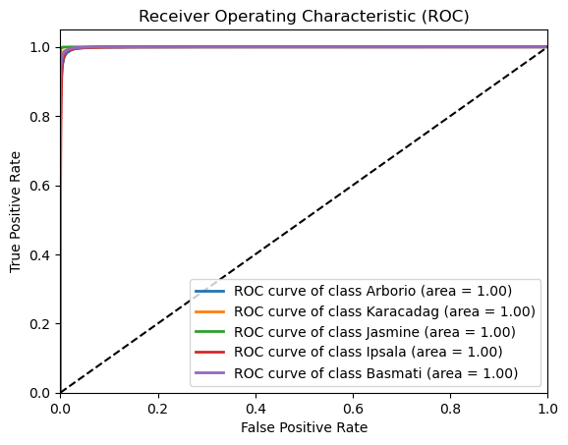
Evaluation and Results Visualization VGG-16
Notes:
The ROC curves and AUC values demonstrate that the model performs exceptionally well for all classes, with nearly perfect classification for Arborio, Ipsala, Karacadag, Basmati and Jasmine (AUC = 1.00). This indicates that the model is highly accurate and effective in identifying the correct class for each instance.

Slide 22
Classification Report
Baseline Model
CNN original architecture
5 hours 11 min
Tuned Baseline Model
CNN original architecture
2 hours 42 min
ResNet50V2
ResNet50V2
9 hours 40 min
Resnet50V2
VGG-16
Tuned ResNet50V2
Tuned ResNet50V2
10 hours 25 min
12 hours 3 min
0.99
0.02
0.94
0.40
0.97
0.08
0.988
0.03
0.988
0.079
Name
Architecture
Training Time
Val accuracy
Test loss

Slide 23
Conclusions
Summary of Findings
The rice image classification project demonstrates the potential of using advanced machine learning techniques to automate and improve the accuracy of rice type identification.
By leveraging convolutional neural networks (CNNs) and image processing technologies, we have developed a robust model capable of distinguishing between various types of rice grains based on their visual characteristics.

Slide 24
Recommendations
Future enhancements to this project could include
Model fine-tuning: further fine-tuning the model using advanced techniques such as ensemble learning, more sophisticated image preprocessing steps and exploring the use of other deep learning architectures could yield even better performance
Scalability: The dataset could be enhanced with additional rice grain variants in future to cater for other varieties like Bomba, Calasparra, Valencia etc. currently not classified.
Integration with other systems: Integrate the classification system with existing agricultural or inventory management systems for broader application.
Incremental Learning: Implement incremental learning to update the model with new data without retraining from scratch.

Slide 25
Thank you

